Slide 1
CUSTOMER RETENTION
-Milind B Kuwar

Slide 2
Abstract
Customer satisfaction has emerged as one of the most important factors that guarantee the success of online store; it has been posited as a key stimulant of purchase, repurchase intentions and customer loyalty
Five major factors that contributed to the success of an e-commerce store have been identified as: service quality, system quality, information quality, trust and net benefit.

Slide 3
Objective
The objective of the project is to apply analytical skills to give findings and conclusions in detailed data analysis of E-retail factors for customer activation and retention.

Slide 4
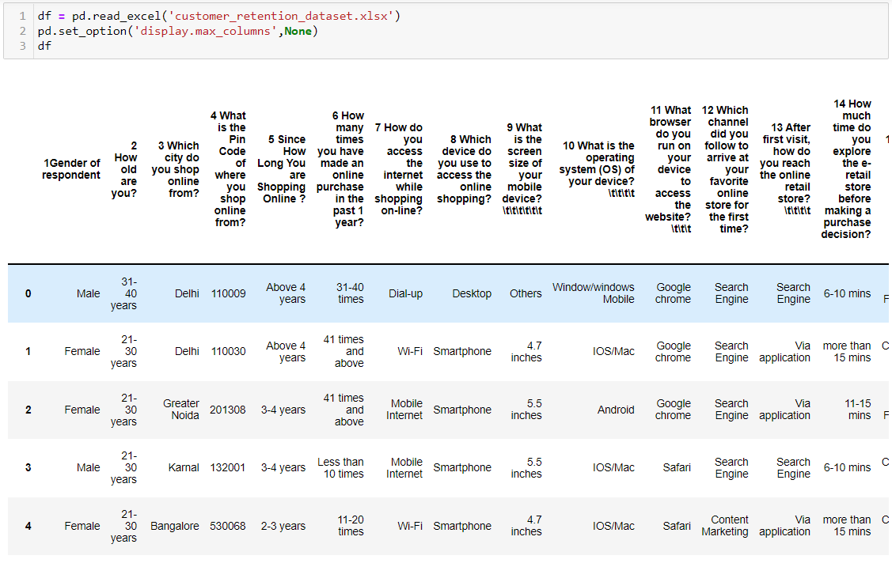
Data Information
The dataset contains 71 features and 269 rows.
The dataset contains no NULL values.
All the attributes are of ‘object’ type except the PIN code.

Slide 5
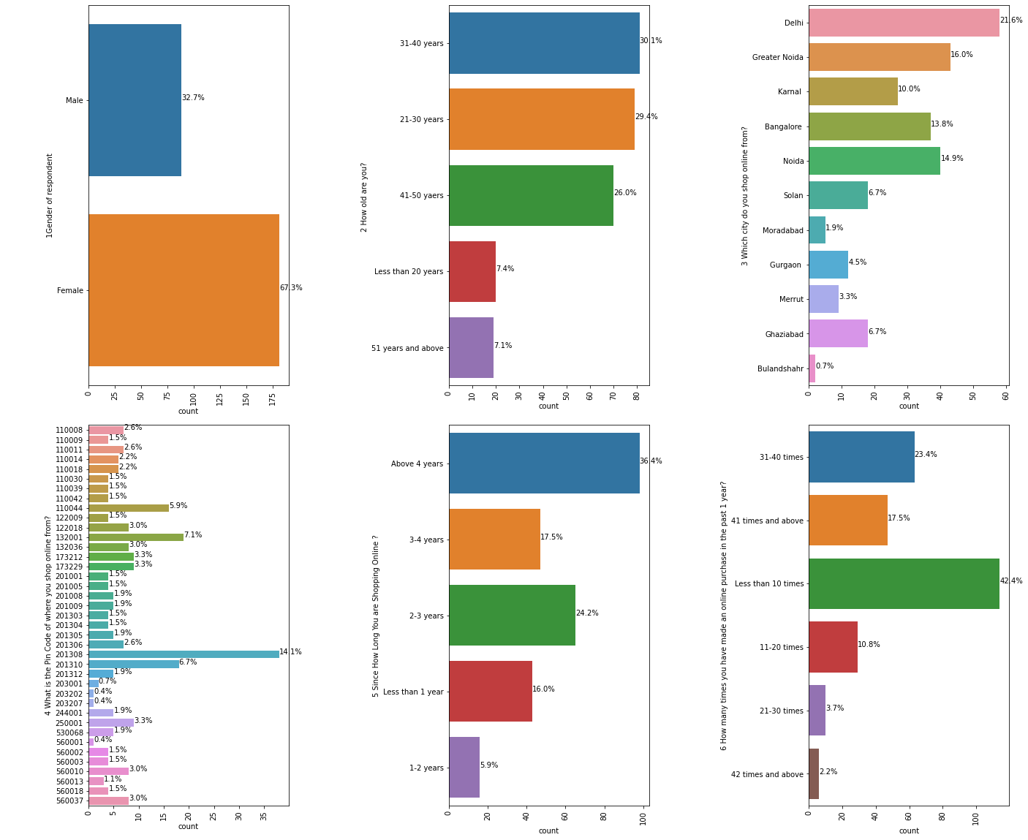
Data Visualization

Slide 6
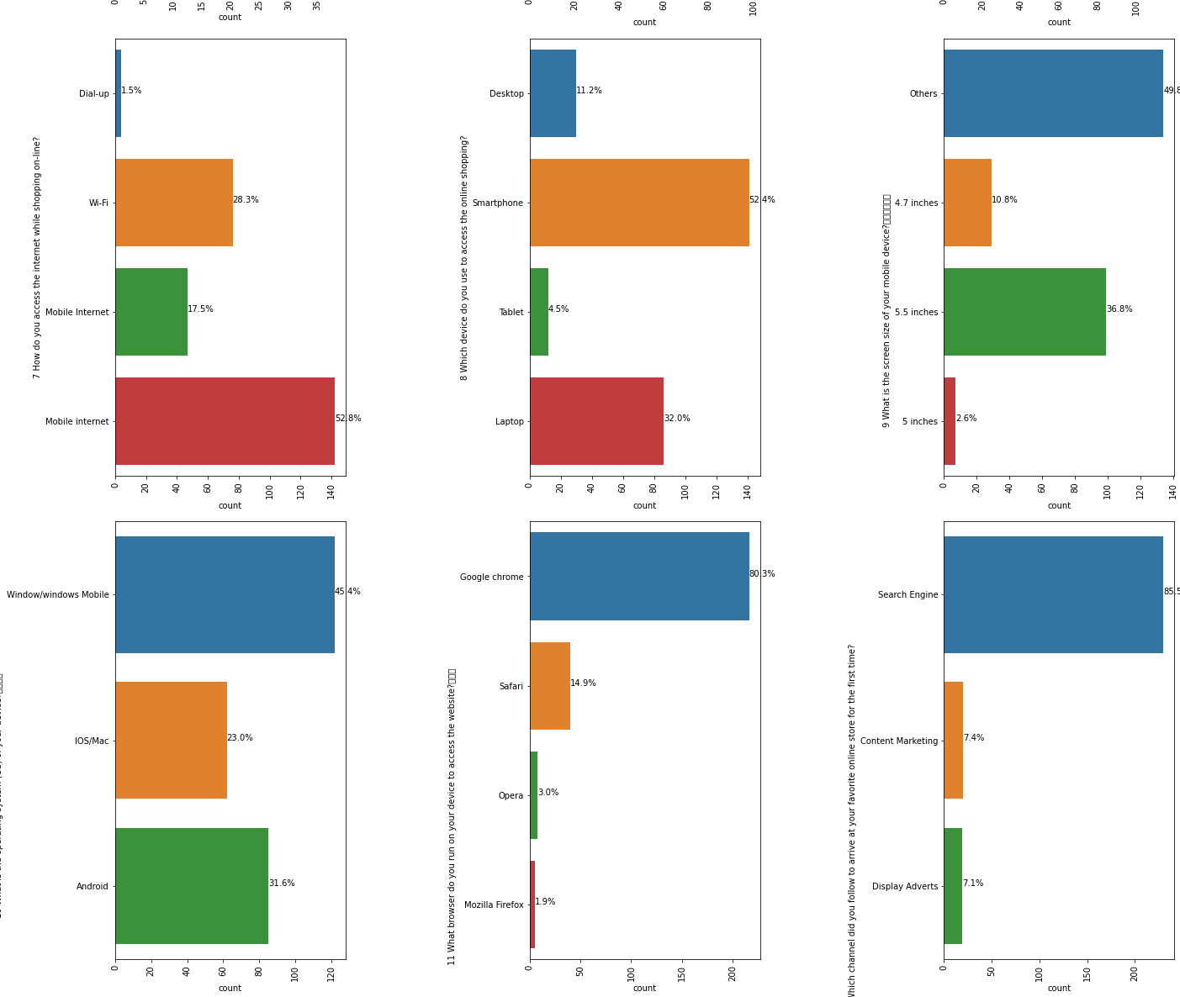

Slide 7
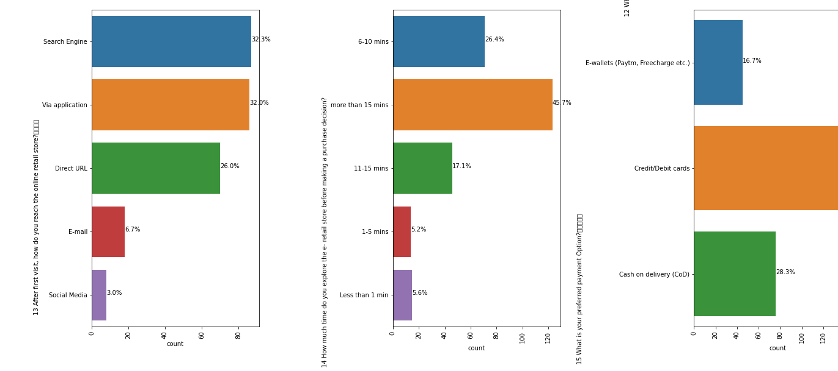
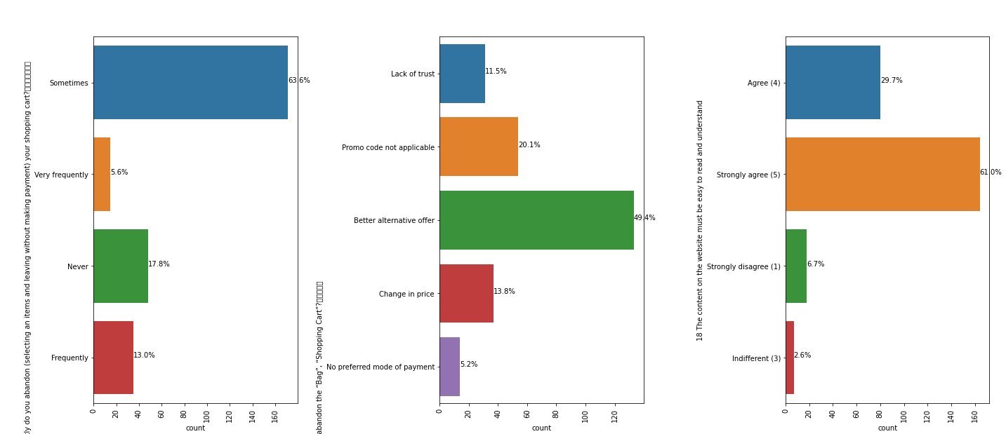

Slide 8
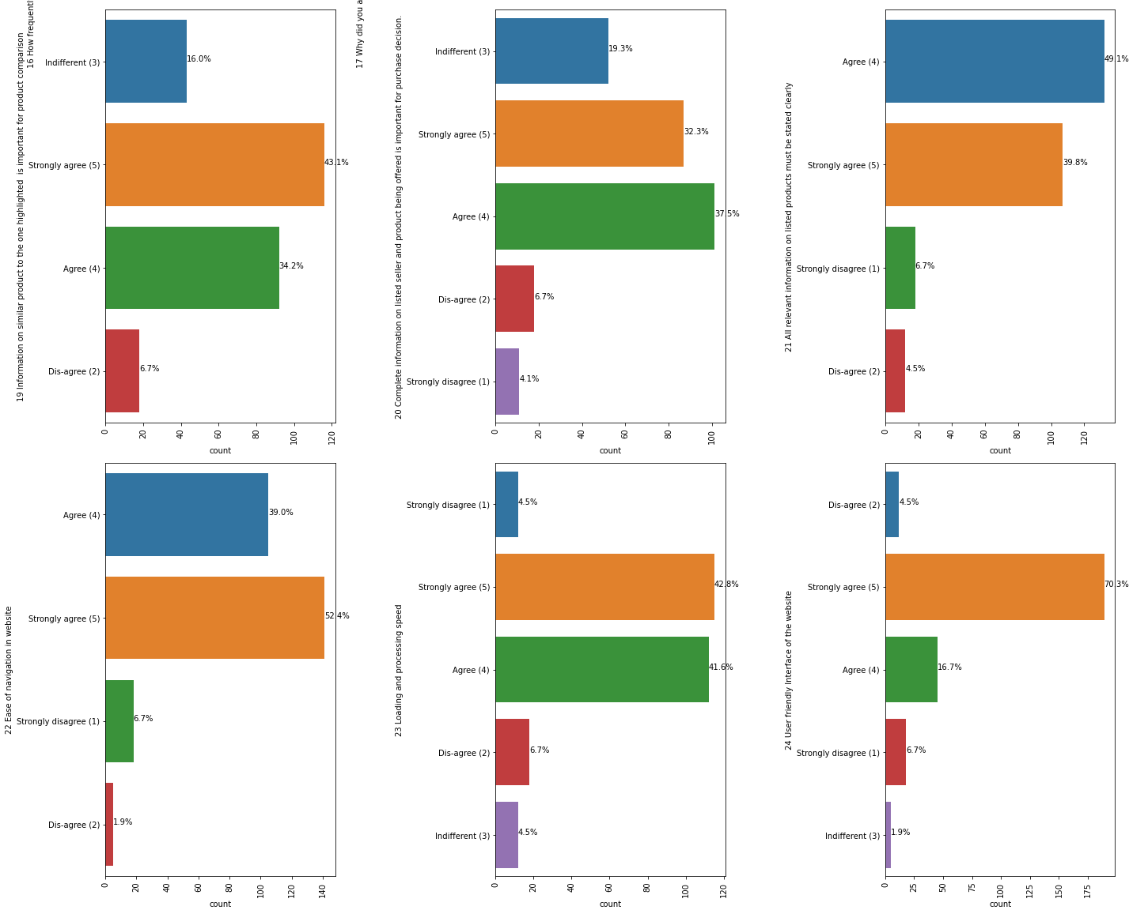

Slide 9
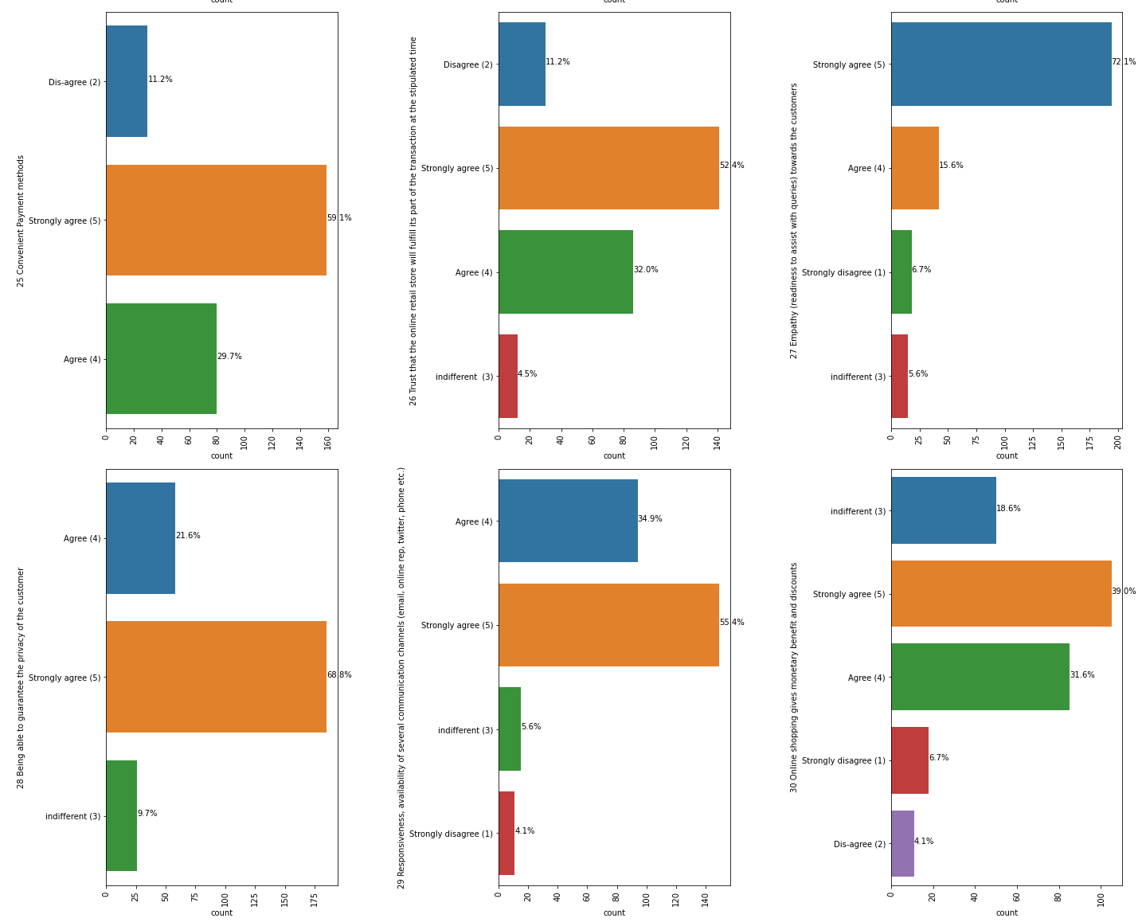

Slide 10
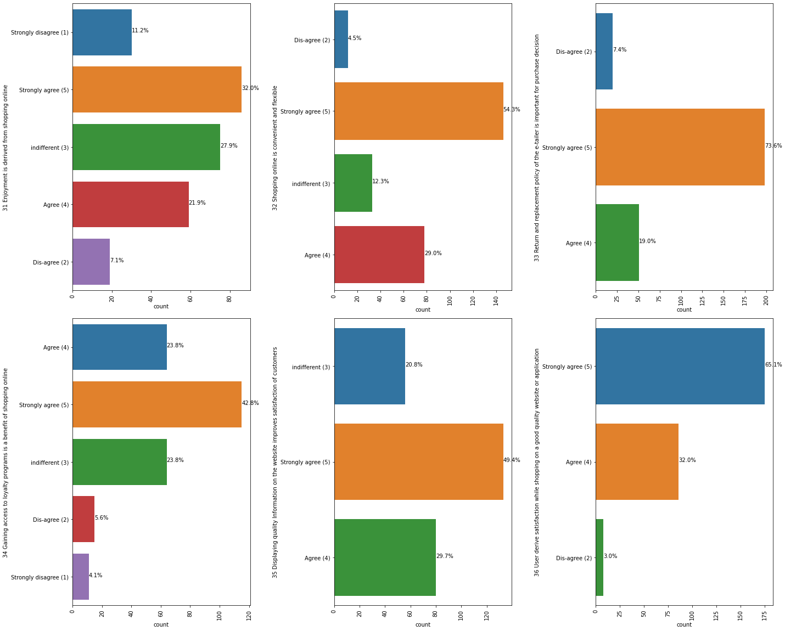

Slide 11
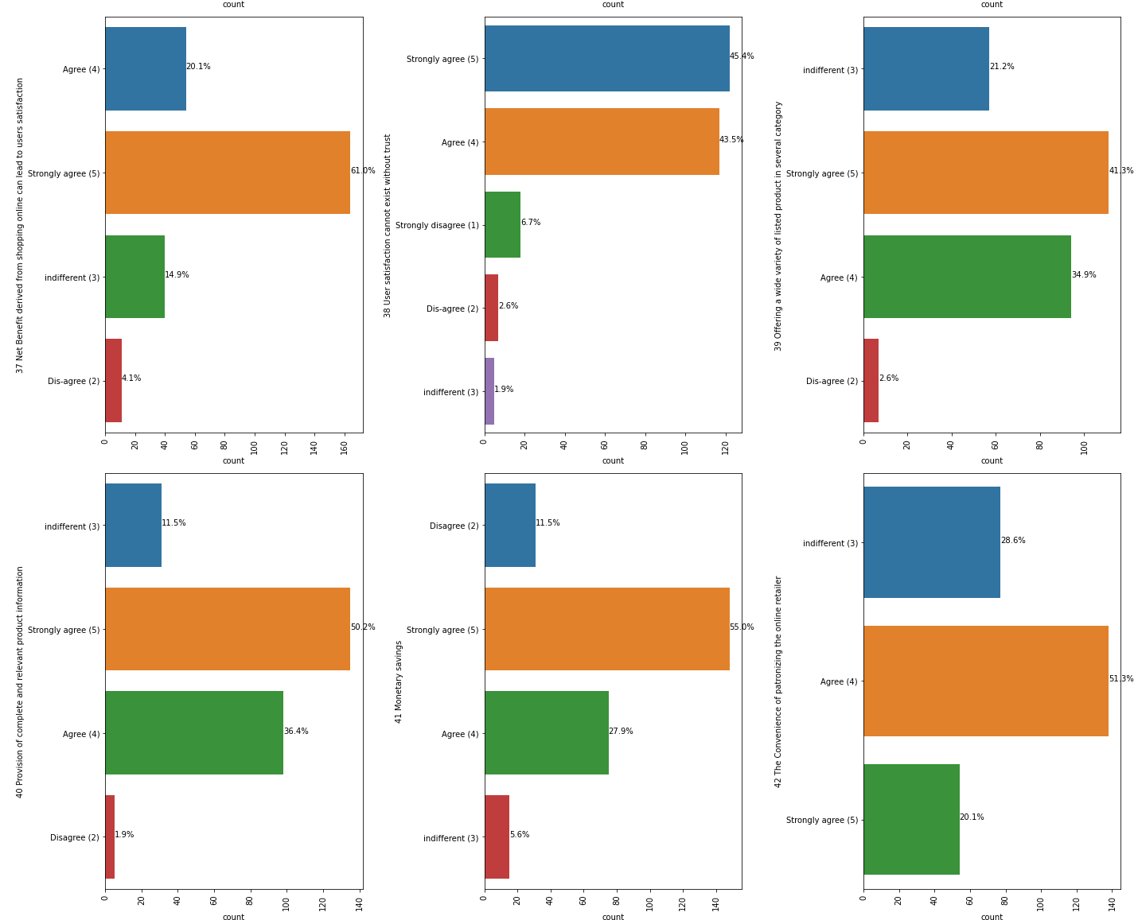

Slide 12
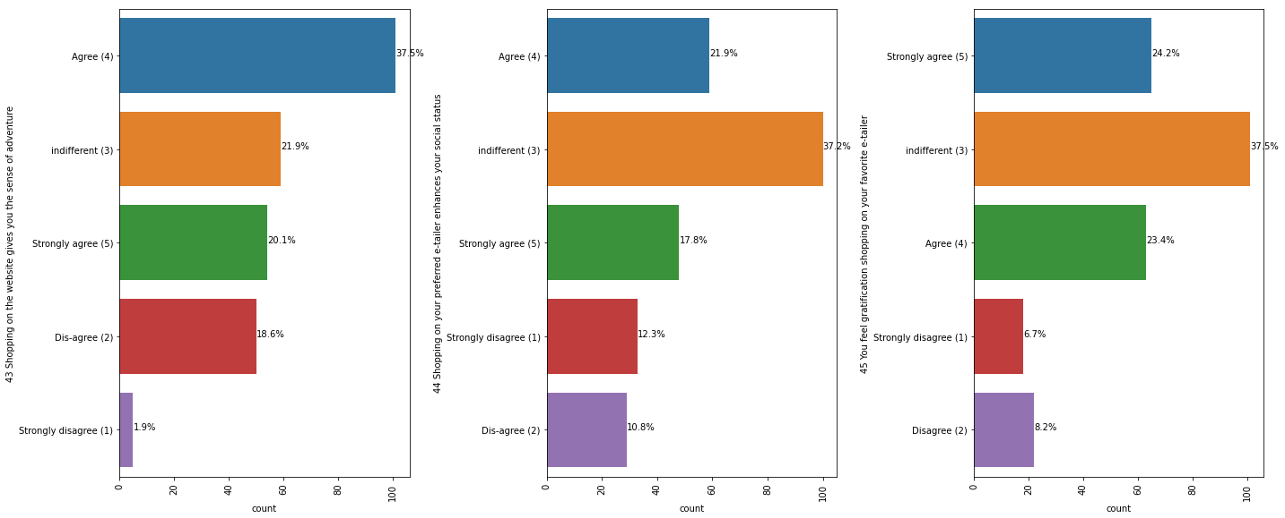
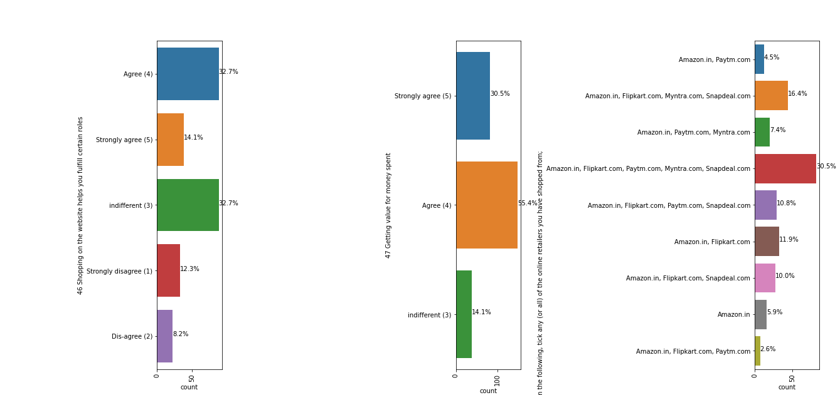

Slide 13
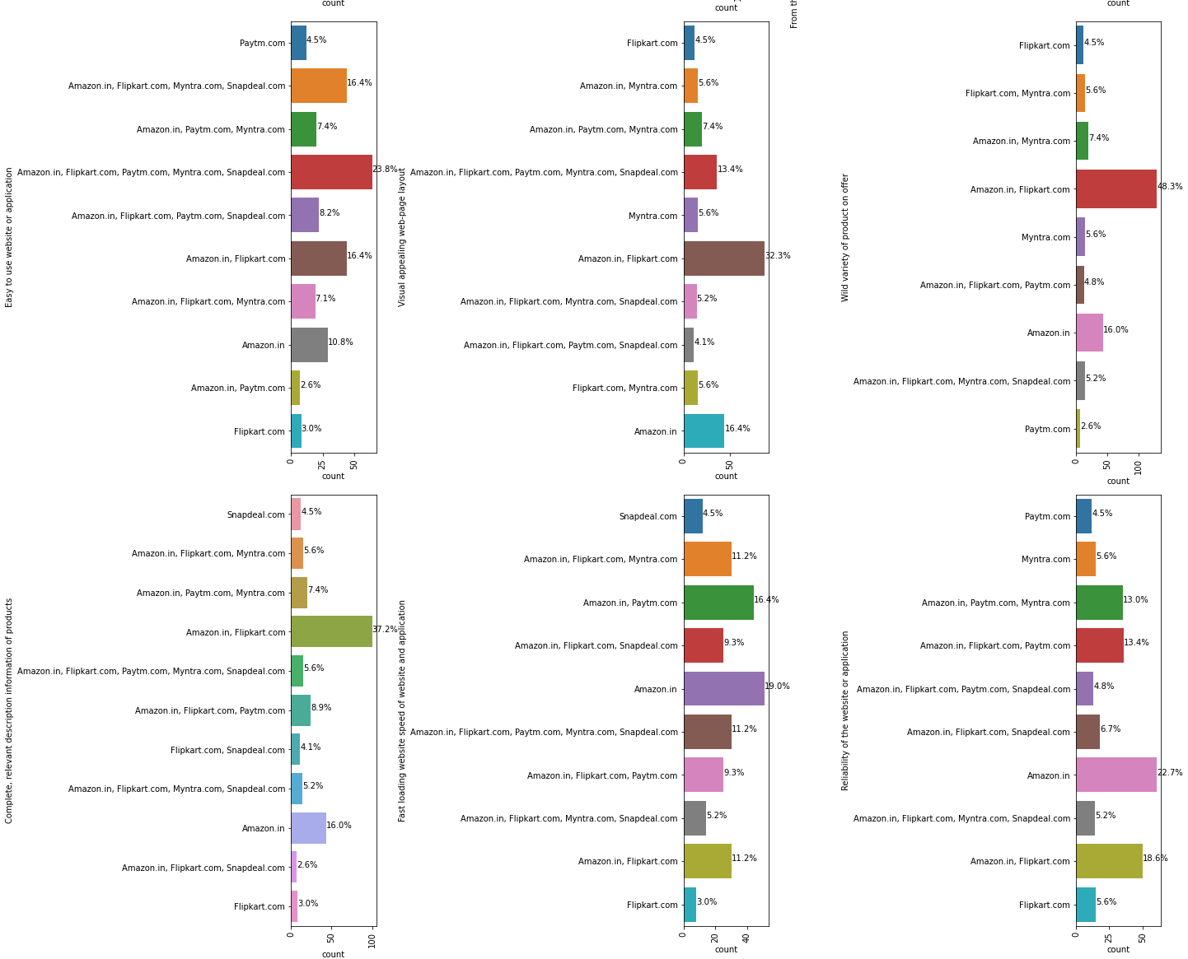

Slide 14
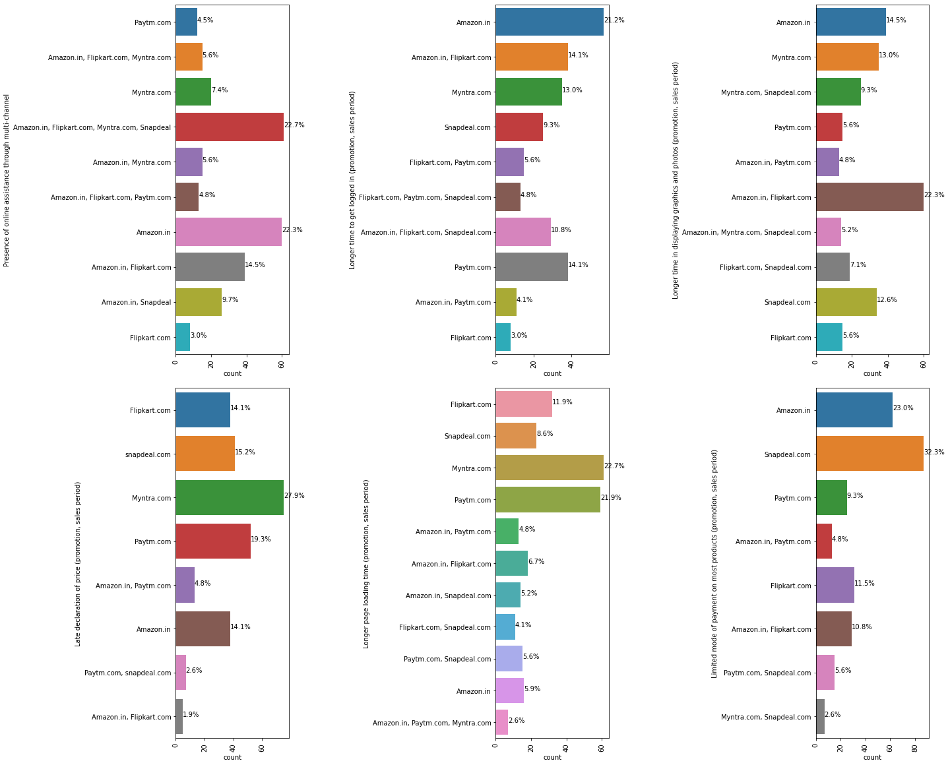

Slide 15
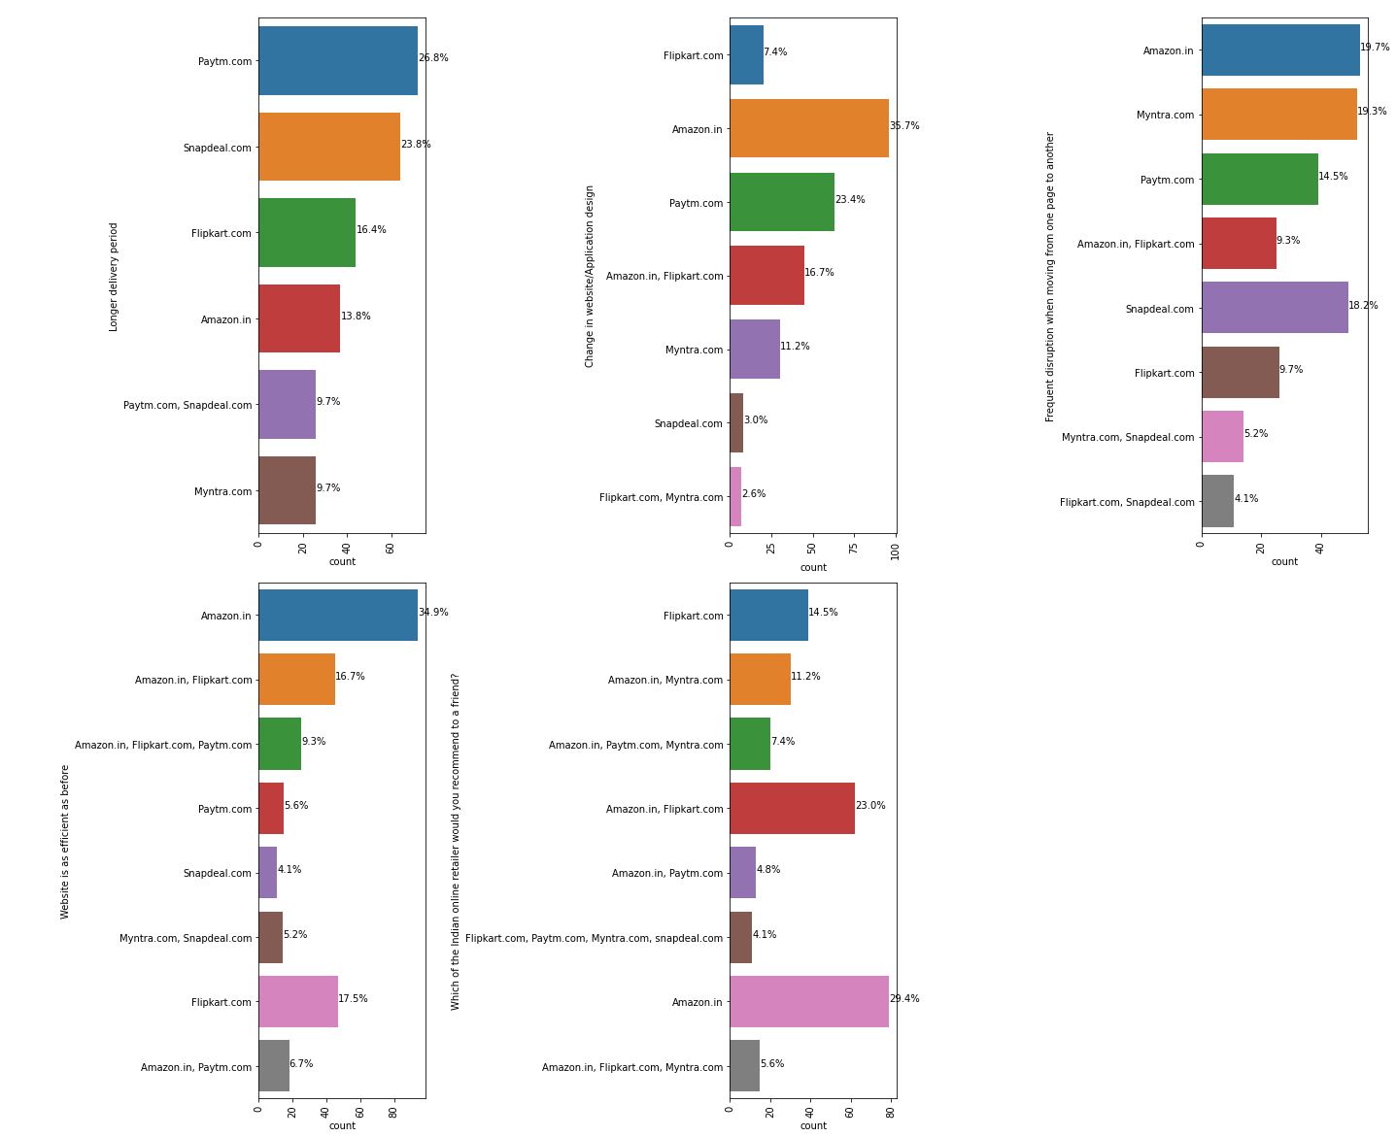

Slide 16
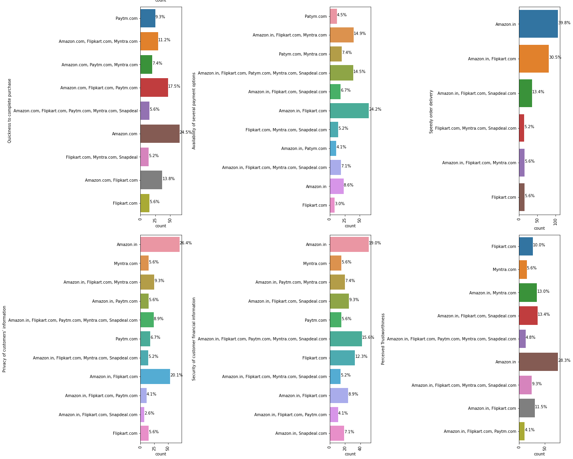

Slide 17
Conclusion
Females shop more than males, hence they're the target audience.
People in age group of 31-40 years shop maximum and least is done by 51 years.
People in metropolitan cities (Delhi, Greater Noida, Bangalore and Noida) exercise more online shopping.
Shoppers prefer Card payment option followed by COD.

Slide 18
Most of the shoppers strongly agree that
- content on the website must be easy to read and understand,
- Must have all the information on listed seller and product,
- There must be ease of navigation in website,
- Must have convenient payment method,
- must have empathy towards the customers
- online shopping gives monetary benefit and discounts
- There must be return and replacement policy of the e-tailer for purchasing

Slide 19
Shoppers agree that they are getting value for money spent
They also strongly agree that Amazon.in, Paytm.com and Myntra.com are easy to use and maximum shopping has been done from these websites, also they have complete and relevant information of products
Amazon and Flipkart offer wide variety of products Amazon has fastest delivery followed by Flipkart and Myntra. Also they are highly satisfactory in terms of privacy of customer information.
Moreover Amazon website is best since its extremely efficient. Snapdeal provides limited mode of payment and has frequent disruption on moving from one page to other. Most of the people would refer Amazon to others.
Females in age group 21-30 years do maximum shopping.

Slide 20
Females from greater Noida and males from Delhi do maximum shopping
Most of the females shop from Amazon, Flipkart, Paytm, Myntra, Snapdeal as they find it easy to use and find amazon reliable
Males find amazon, Flipkart and Paytm to be equally reliable.
Both male and female agree that amazon is as efficient as before.
Moreover they both would recommend amazon to a friend.
Shopping on your preferred e-tailer enhances your social status: This attribute has only 17% of the customers who strongly agree. This is because most of the customers will go to the shopping malls for the social status as ordering online doesn't usually help in showing off.

Slide 21
The Convenience of patronizing the online retailer : This attribute has only 20% of the customers who strongly agree. This means that the customers are not much concerned about patronizing with the retailer.
Return and replacement policy of the e-tailor is important for purchase decision: It has whopping 73% of the customers who strongly agree to it. It is evident from the fact that people cannot actually try, touch and feel the products that they are purchasing before they reach home and they would want to return or replace in case of dissatisfaction. Online shopping websites should make strategies around easy return and replacement policy if they want to retain their customers.
Empathy (readiness to assist with queries) towards the customers: This also has a high percentage of 72. The reason is insecurity amongst the customers. If they have a provision of a helpline number associated with the website, that sense of insecurity vanishes and the customer can trust the website more. A 24X7 support is a must for these online retail stores.

Slide 22
User friendly Interface of the website: Just like the navigation in a physical store should be easy, same is the case with the online retail store so that the customers do not have to work around much and the overall shopping experience is smooth. The retail stores should invest heavily in creating user friendly apps and websites.
Being able to guarantee the privacy of the customer: This also got 68% strongly agree. Everyone is concerned of their privacy. If there is a website that posts about your recent purchase on its social media and tags you without your consent can be a breach of privacy. Imagine buying underwear's and being tagged by amazon on Facebook for doing so.
Convenient Payment methods: This also had 59% people strongly agreeing. Cash on delivery, online cards and upi, all the methods should be available for the customers to make the transaction.
Responsiveness, availability of several communication channels (email, online rep, twitter, phone etc.): In case one channel is not available, customers can reach out to multiple channels which again is an important factor. We have recently seen customers reaching out to Amazon and Flipkart's Twitter handles and raising issues over there which are readily resolved.

Slide 23
Thank You

